Slide 1
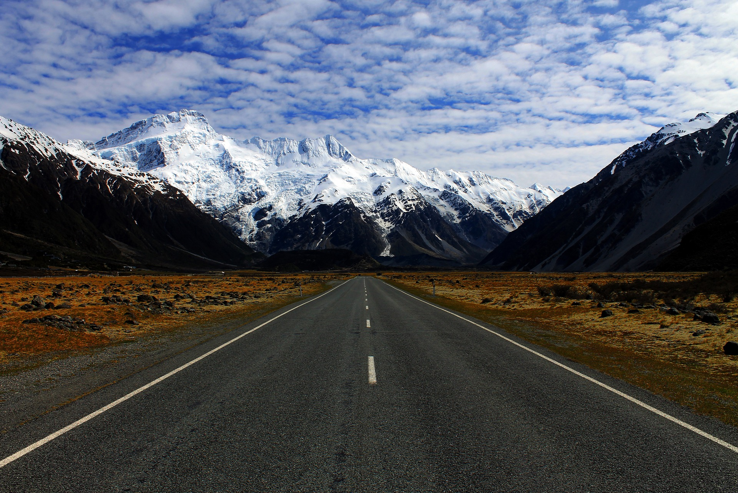
Manuel Álvarez Álvarez
manuel.alvarez.alvarez@cern.ch
A true love story
Monolith
CQRS and ES
Microservices

Slide 2
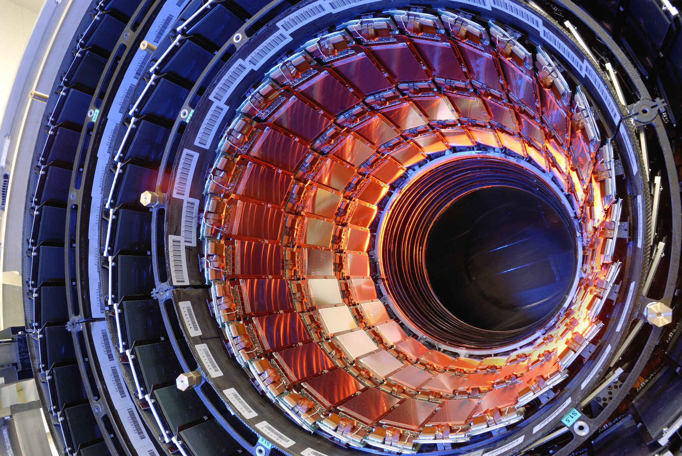
CERN

Slide 3

What should you expect from this workshop

Slide 4

workshop
The particle detector
https://goo.gl/5oiRXy

Slide 5
The workflow
A monolith
A CQRS monolith
microservices

Slide 6
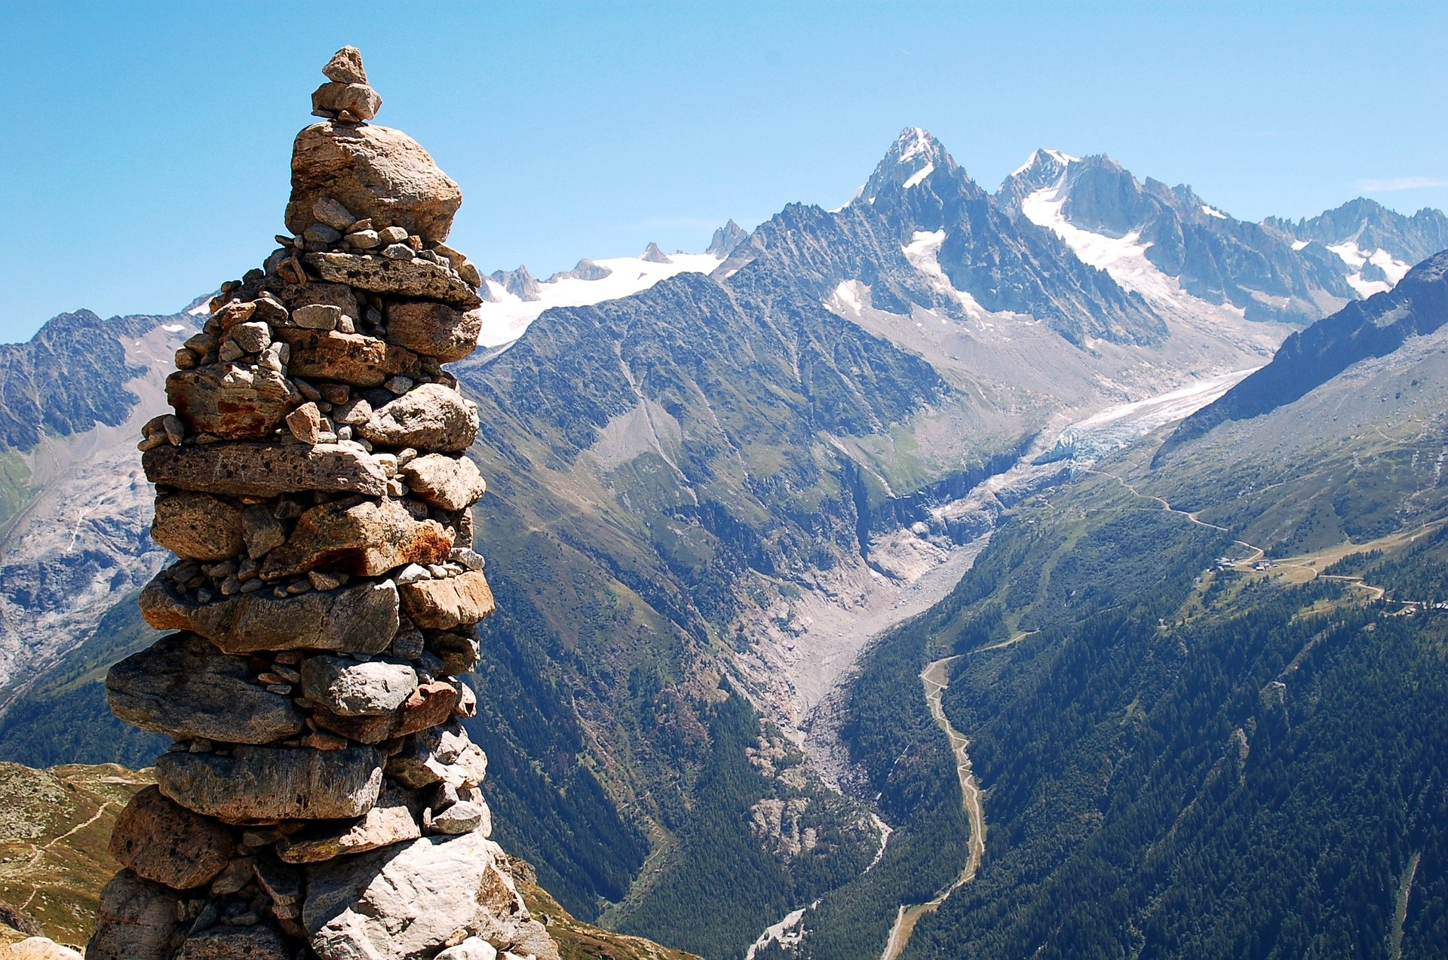
The monolith

Slide 7
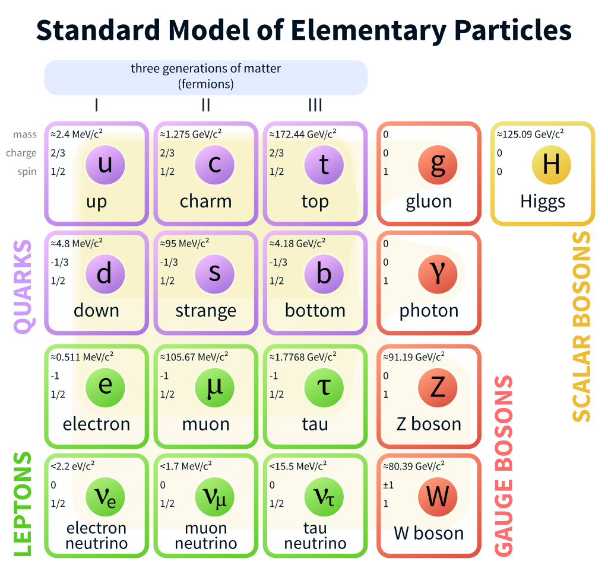

THE DOMAIN
CHAMELEON

Slide 8
The monolith
Spring streams
Zookeper + kafka
monolith
Event store
ACCELERATOR
Collision and
Particle detector
docker

Slide 9
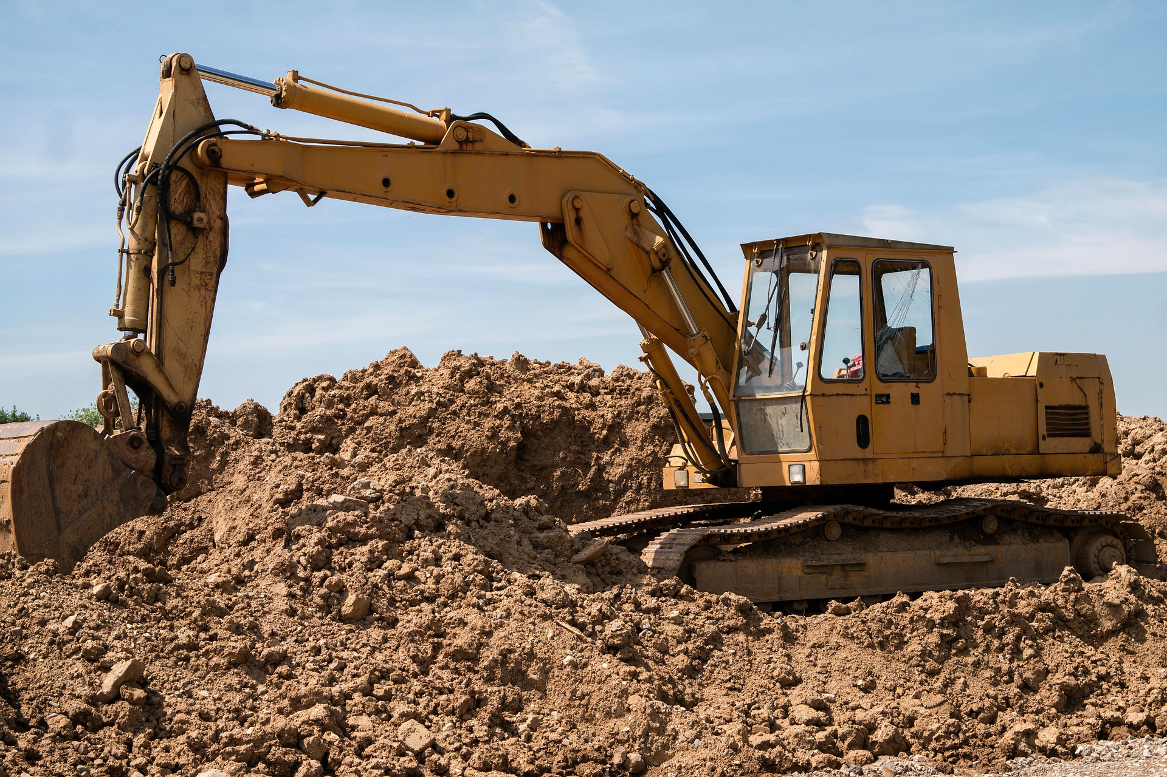
The monolith
$ git clone https://github.com/manuel-alvarez-alvarez/microservices-workshop.git
$ git checkout monolith_start

Slide 10

CQRS

Slide 11
Your domain model
A subscription mechanism
Your write model
Your read model
What does Command Query Responsibility Segregation mean?
Event
Command
Read model
APPLY DDD HERE
APPLY CRUD HERE

Slide 12
autonomous Components
WITH THEIR OWN DOMAIN MODELS
What does Domain-Driven Design mean?
the most important thing for this workshop are Bounded Contexts
Stop thinking about the TECHNOLOGY and think about the DOMAIN first
PART OF THE SAME SYSTEM
only runtime dependencies
Run in Isolation
EXCHANGE EVENTS
https://msdn.microsoft.com/en-us/library/jj591572.aspx

Slide 13


Slide 14
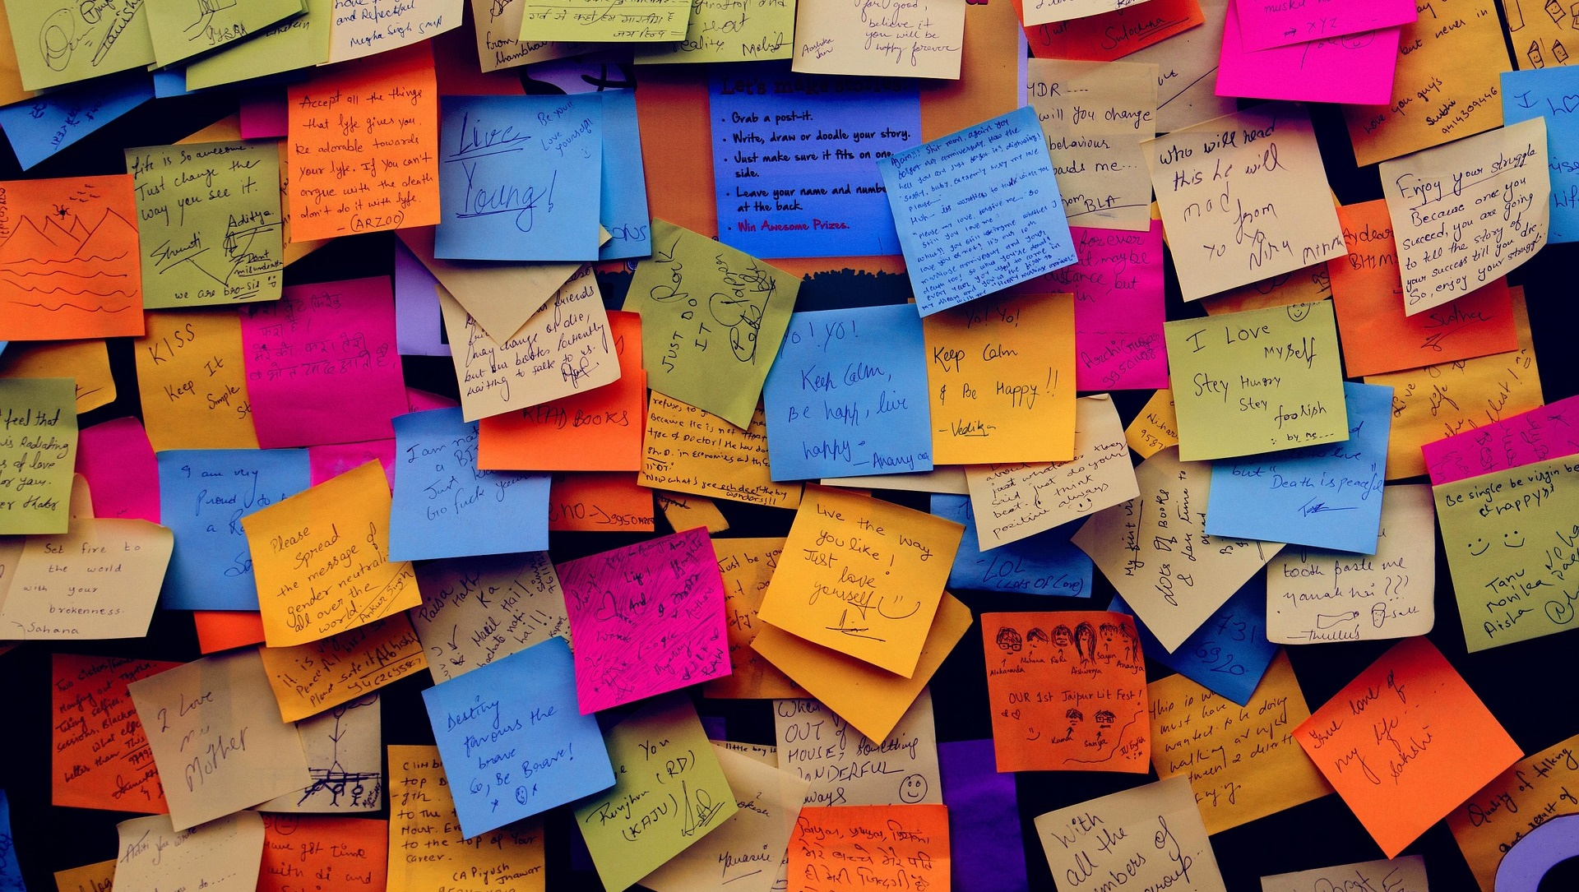
EVENT SOURCING

Slide 15
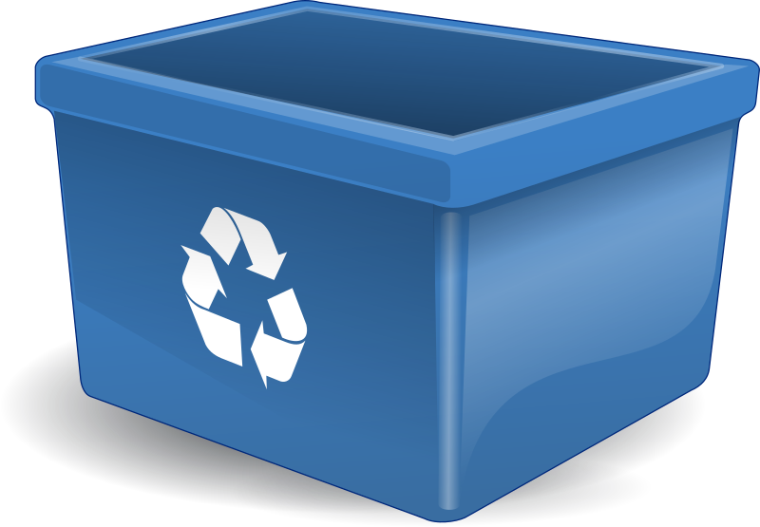
Traditional approach
Event sourcing
Your database mutates
SHIPMENTS
EVENT
ID
Event type
payload
6
3
Shipment created
7
3
Shipment shipped
5
2
Shipment shipped
8
3
Shipment delivered
{timestamp=01/02/2017}
{timestamp=23/02/2017}
{timestamp=01/03/2017}
{timestamp=07/03/2017}
4
1
Shipment delivered
{timestamp=22/01/2017}
What is Event-Sourcing?
3
2
SHIPMENTS
Shipment created
{timestamp=15/01/2017}
2
1
ID
STATUS
TIMESTAMP
Shipment shipped
{timestamp=12/12/2016}
3
delivered
07/03/2017
3
2
SHIPPED
Shipped
01/03/2017
3
new
01/02/2017
1
1
Shipment created
23/02/2017
{timestamp=01/12/2016}
1
delivered
22/01/2017
You are losing data

Slide 16


Slide 17
THE CQRS monolith
Custom framework
CQRS monolith
Write model
Read model
Event store
ACCELERATOR
Collision
detector
Particle
detector
collision
docker

Slide 18
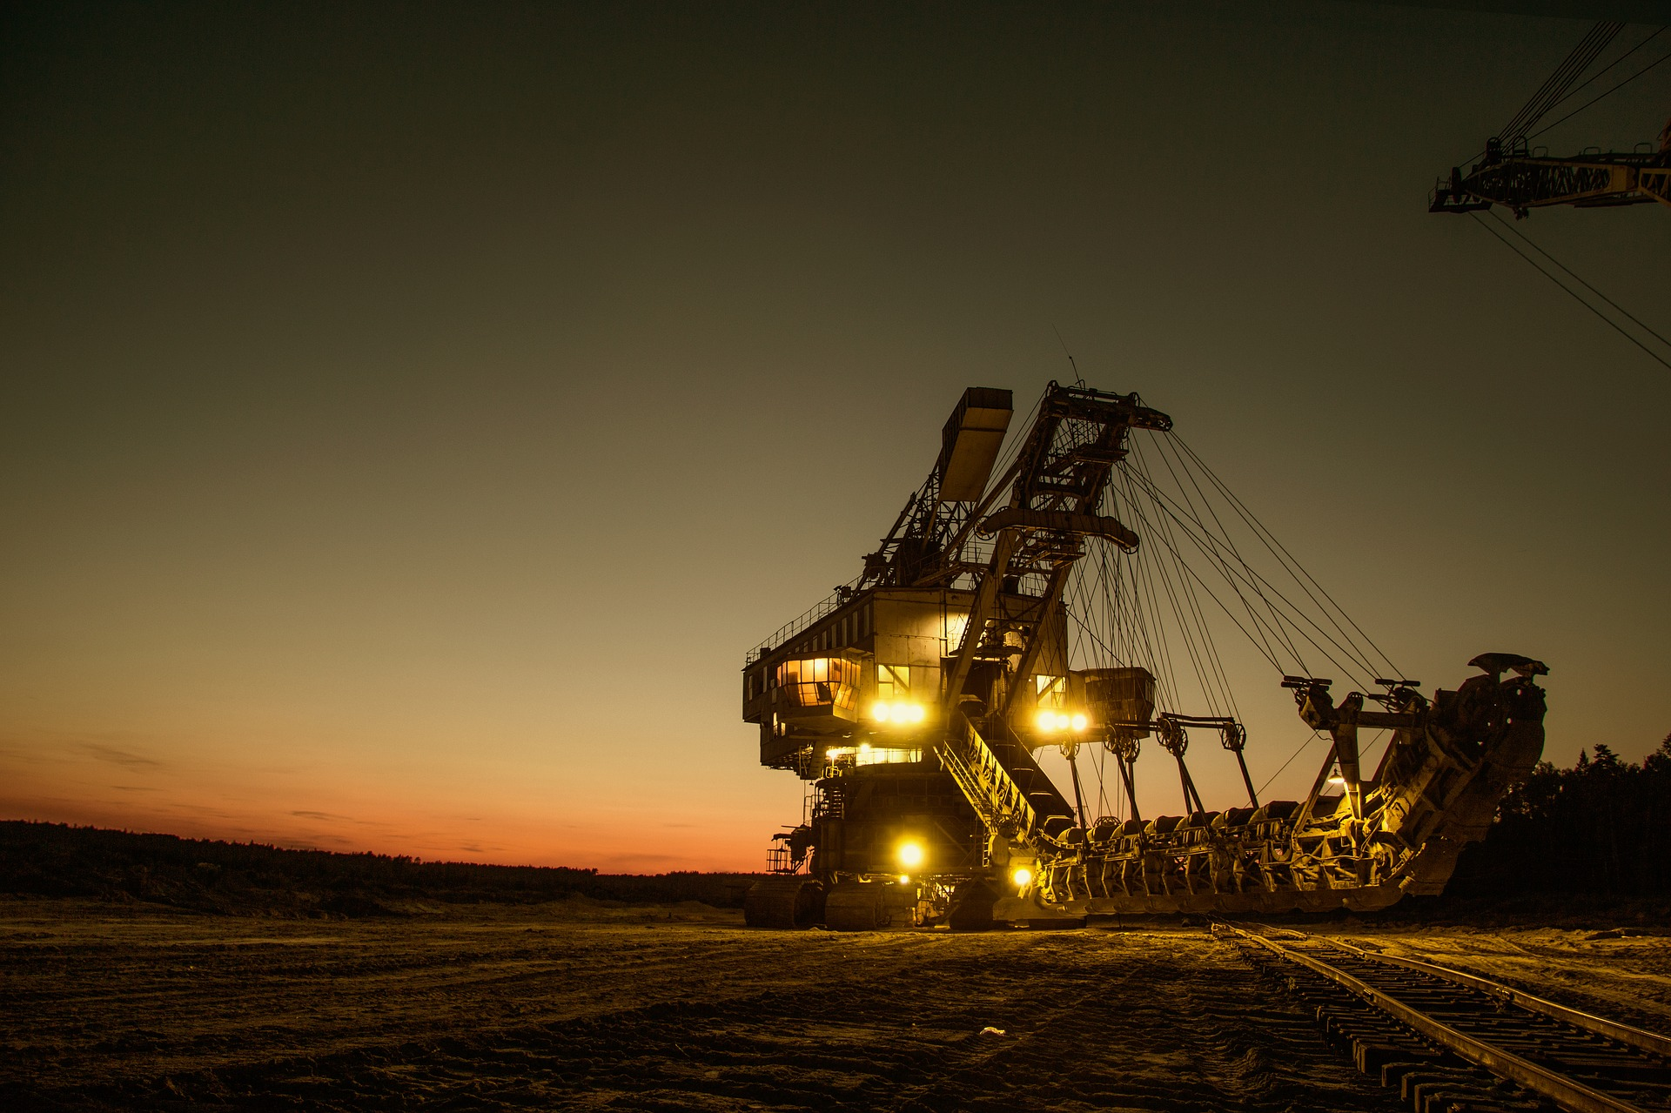
THE CQRS monolith
$ git stash save --all beautiful_monolith
$ git checkout cqrs_start

Slide 19
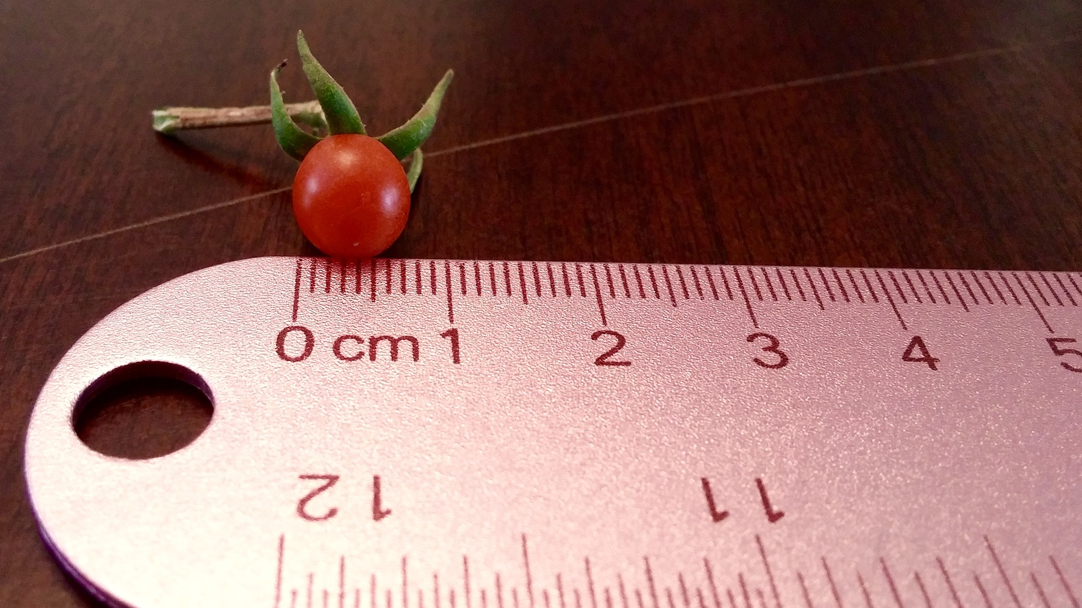
Microservices

Slide 20
Processes communicating with each other
Easy to replace
Organized around capabilities
Different technologies
Small in size
https://en.wikipedia.org/wiki/Microservices

Slide 21


Slide 22
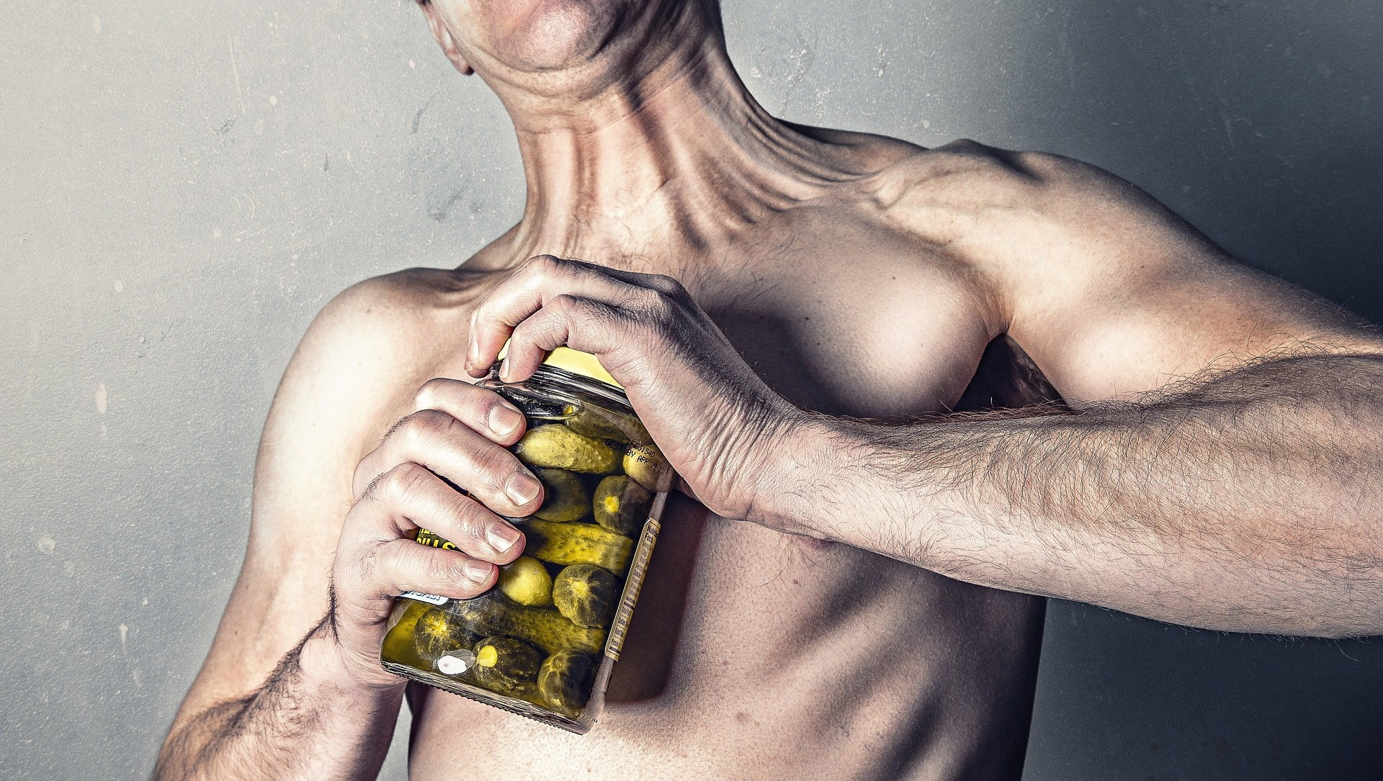
Challenges in Microservices

Slide 23
Back to the DDD world
Catalog service
catalog
shipping
product added to the catalog
Shipping service
Your order has been shipped
How BIG should a Microservice be?
sales
Inventory
goods added to the inventory
A product has been purchased
Inventory service
Sales service

Slide 24
Back to the event sourcing world
Catalog
service
Shipping
service
How can I make my microservices SPEAK to each other?
EVENTS
Sales
service
Inventory
service

Slide 25
THE CQRS microservices
Write model
Write model
eureka
Collision
detector
Particle
detector
Spring cloud
Read model
Read model
zuul
Event store
accelerator
COLLISIONS
STATISTICS
docker

Slide 26
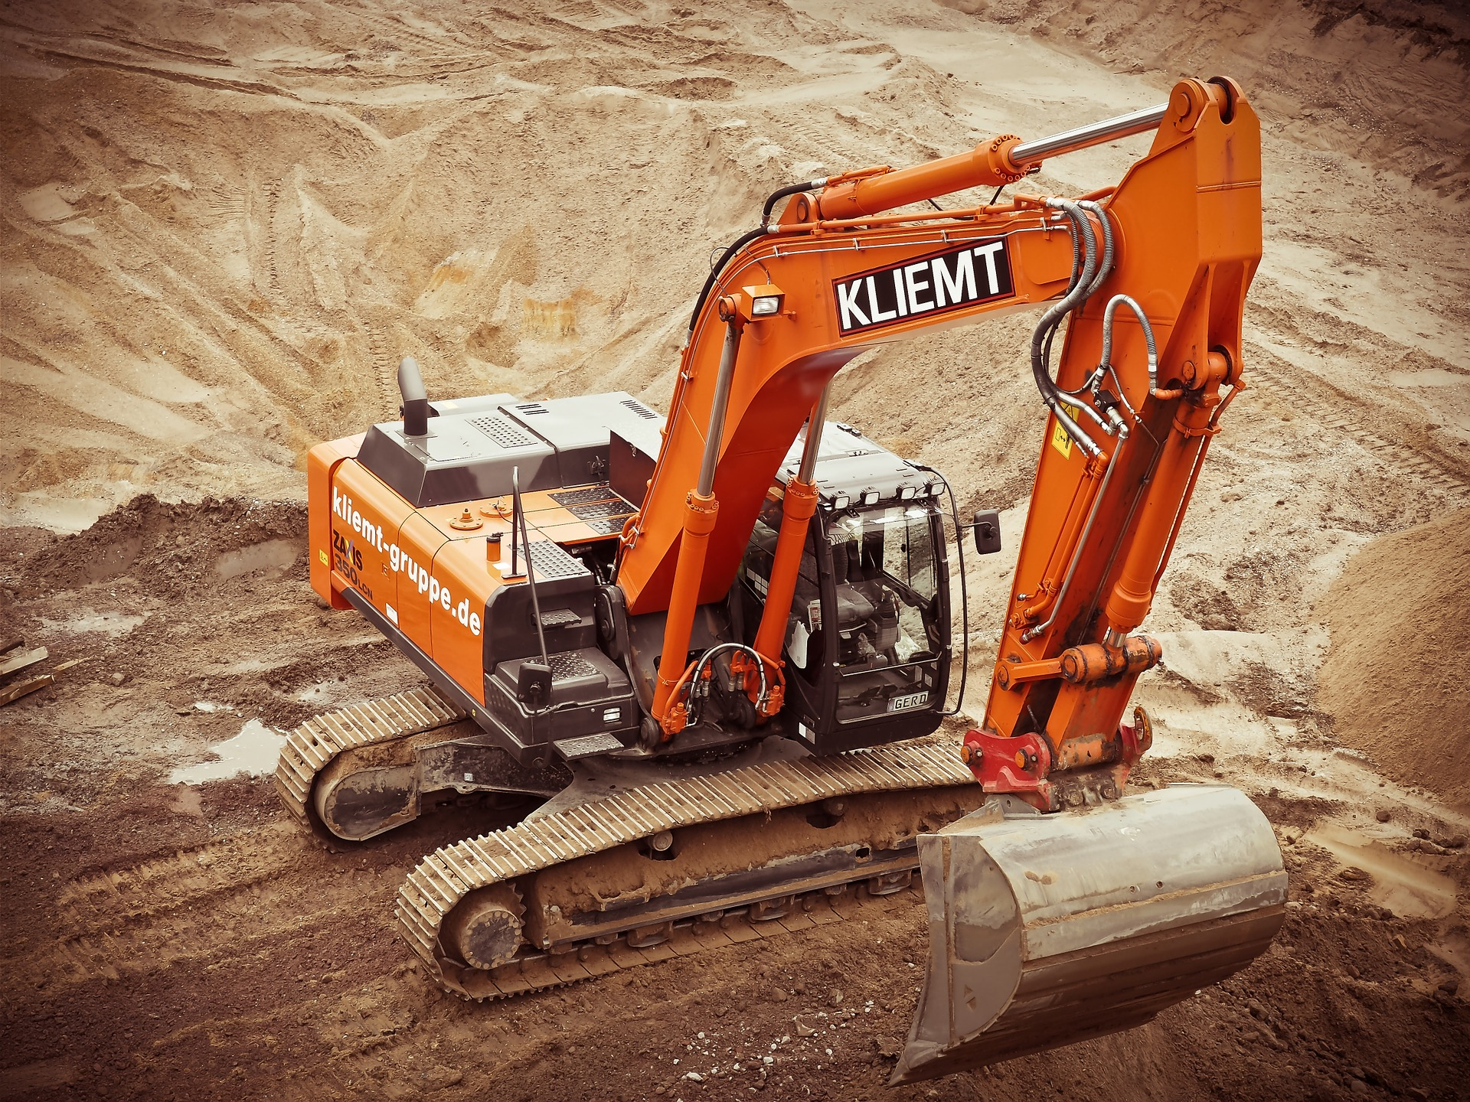
THE CQRS microservices
$ git stash save --all cqrs_rocks
$ git checkout microservices_start

Slide 27


